Slide 1
FinTech

Slide 2
GDP
GNP
Purchasing Power
Monetary exchange

Slide 3
Technology Enabled
Enterprise

Slide 4
Haw has technology changed the business models
Is it a product / service : business implications
Technology Adoption
What are the enablers
What are the retarders

Slide 5
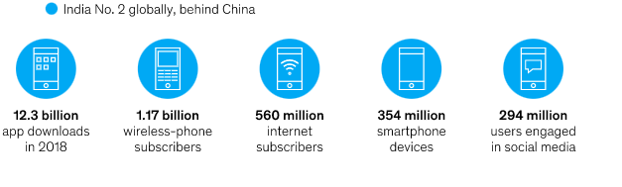
Adoption of Technology

Slide 6
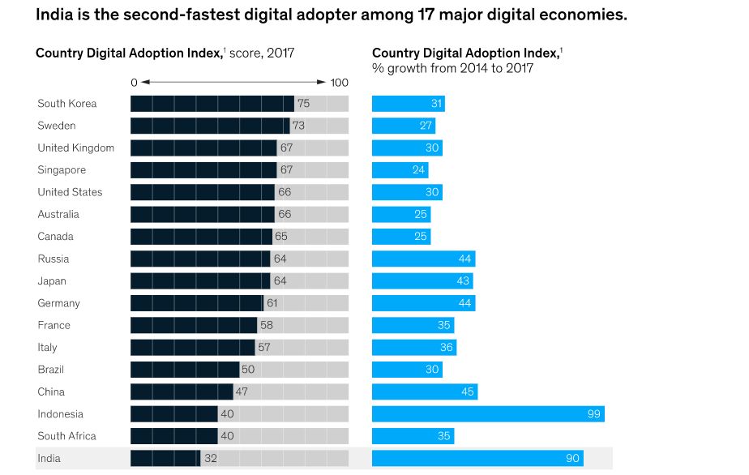

Slide 7
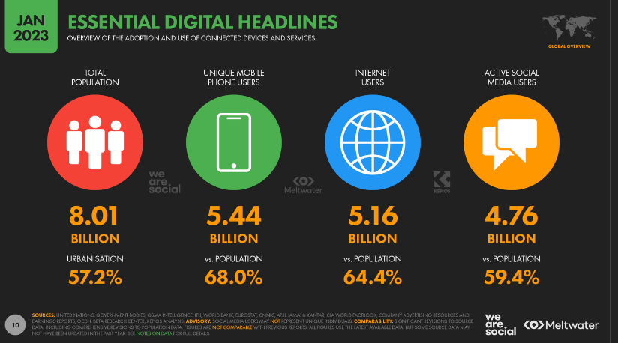

Slide 8
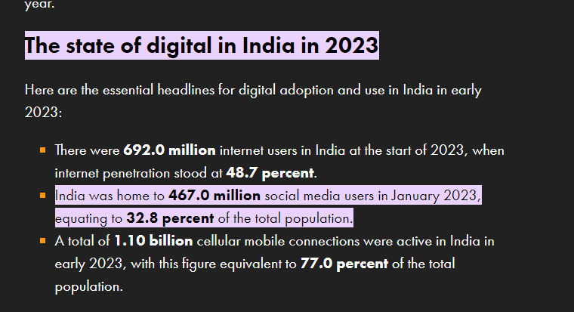

Slide 9
Is technology adoption similar across population ?
Why does it differ ?
Laggards
Leaders
Is technology adoption similar across organizations ? ( size, type of industry )

Slide 10
Refer Report
https://www.mckinsey.com/business-functions/mckinsey-digital/our-insights/digital-india-technology-to-transform-a-connected-nation

Slide 11
What is Fintech ?
Is it Banking ?
Aims to complete with traditional means of banking and finance
Integrates banking and finance with modern technology to enhance use and service delivery to customers
Banking App : various functions
3 segments : B2B,B2C& C2C

Slide 12
Financial Stability Board defines fintech as ―
technologically enabled financial innovation that could result in new business models, applications, processes or products with an associated material effect on financial markets and institutions and the provision of financial services

Slide 13
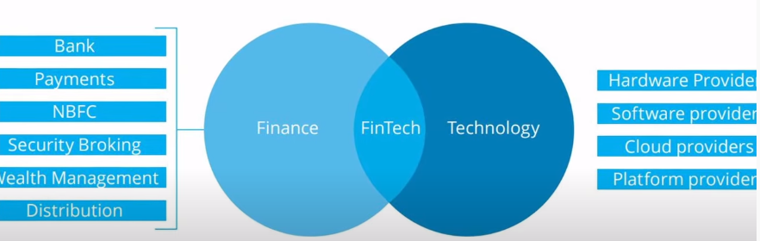
What is Fintech ?

Slide 14
NBFCs are not subject to the banking regulations and oversight by federal and state authorities adhered to by traditional banks. Investment banks, mortgage lenders, money market funds, insurance companies, hedge funds, private equity funds, and P2P lenders are all examples of NBFCs.
Securities brokers, also called securities, commodities, and financial services sales agents, advise customers who want to make financial investments.
Wealth management is an investment advisory service that combines other financial services to address the needs of affluent clients.

Slide 15
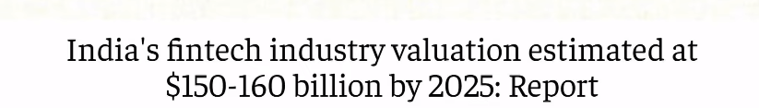

Slide 16
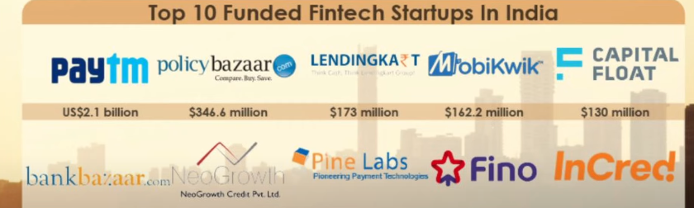
67 % of the start ups have been formed in the last 5 years

Slide 17
App downloads

Slide 18
Evolution
Phase 1 : Fintech 1.0
1866-1967
First fund transfer in USA
Phase 2 : Fintech 2.0
1967 – 1990
ATM, SWIFT transactions
Digital stock exchange
1990s: Paypal
2008 : SUBPRIME crisis (mortgage-backed securities , for TPA investors MBS was a safe bet with low risk and right return in comparison to debt,, predatory lending practices Dodd Frank Law), startups, venture & angel investors
Adoption : faster in India and China
FinTech was first coined by a New York banker in 1972

Slide 19
Phase 3 : Fintech 3.0
Post 1991
Banking
Peer to Peer lending
Other applications

Slide 20
Banking VS
Traditional
Slower adoption of technology
Banks are now targeting customers selectively
FINTECH

Slide 21
Key Market Trends

Slide 22
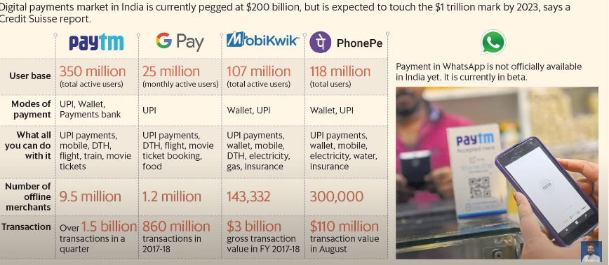
Key Market Trends

Slide 23
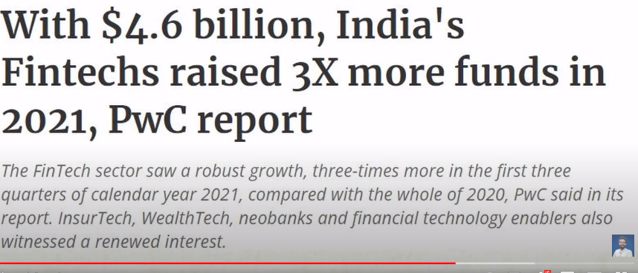

Slide 24
Challenges
PtoP Lending
Consumer Data Availability
Data Security

Slide 25
Why is it important
Need of the hour : Universal
Inclusive
Cost effective :
solutions offered are cheaper
Banks are still dependent on traditional business models ( DC)
Secure
Inclusive : involves MSME hence more empowering

Slide 26
Players in the Fintech Sector
Financial Lending : Revolutionalising the LENDING sector

Slide 27
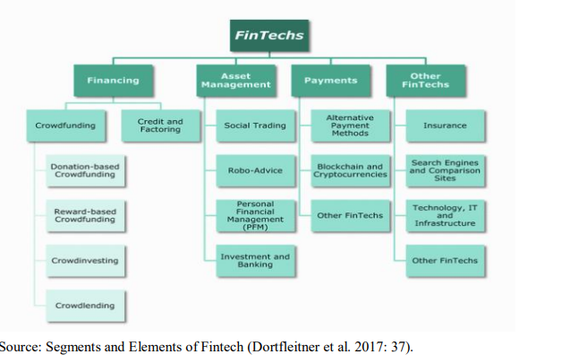

Slide 28
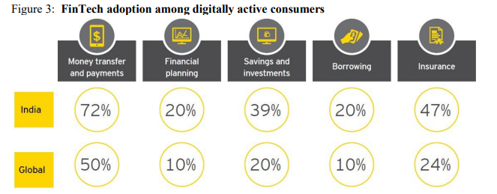
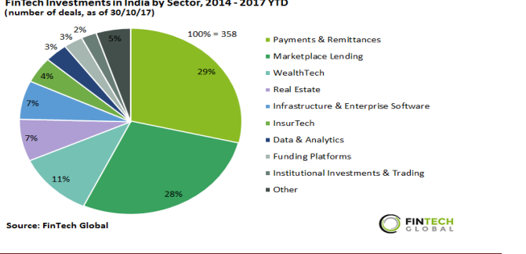

Slide 29
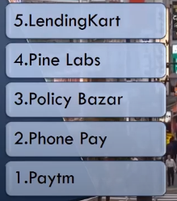
Top 5 Companies In India

Slide 31
UPI : governed by RBI
Alternative lending : lazypay etc
Personal wealth management :
Insuretech : policy management, rick management
Neobanks : virtual banks
Regtech : regularity in reporting, report preparation
Discussion + Neo banks video

Slide 32
https://www.youtube.com/watch?v=enzswdvFBTs @ 4 min

Slide 33
ECOSYSTEM COVERAGE OF THE INDIAN FINTECH SECTOR : P 39 paper

